Slide 1
JAVA ASSIGNMENT Topic : Student Registration Using Swings and MYSQL
Under the guidance of:
Dr . Sumana M
Associate Professor,
Department of Information Science
MSRIT , Bengaluru
Submitted by:
MEGHANA.R - 1MS17IS147
PAVANA.K – 1MS17IS152
JAYASHREE.J – 1MS17IS156

Slide 2
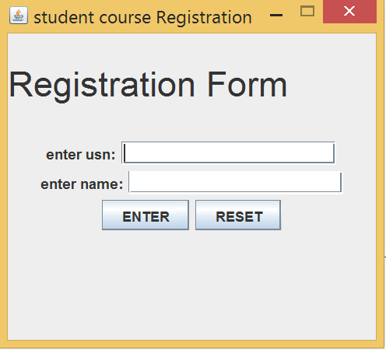
Login page Student needs to enter : 1.usn 2.name

Slide 3
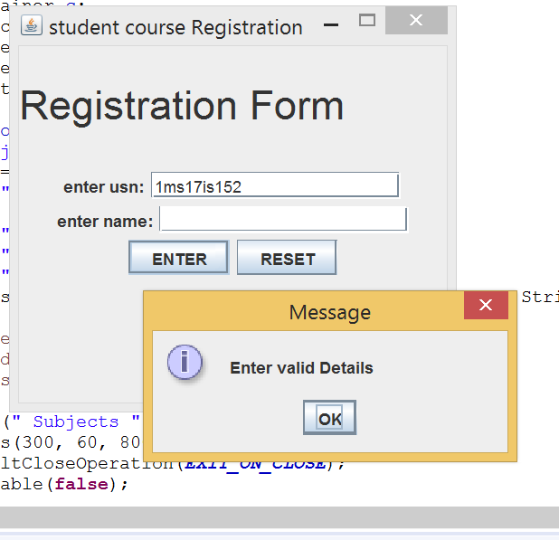
Press then “Enter” Button -> checks for validity ->if invalid, shows a message

Slide 4
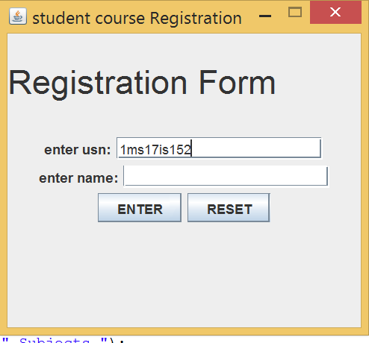
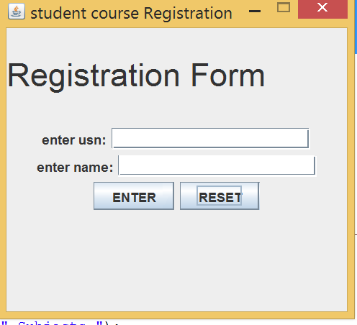
Working of ‘Reset’ Button -> Clears the details entered [on the click of reset]

Slide 5
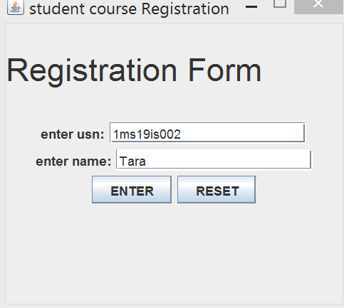
Entry of details done. Click on ‘Enter’ Button

Slide 6
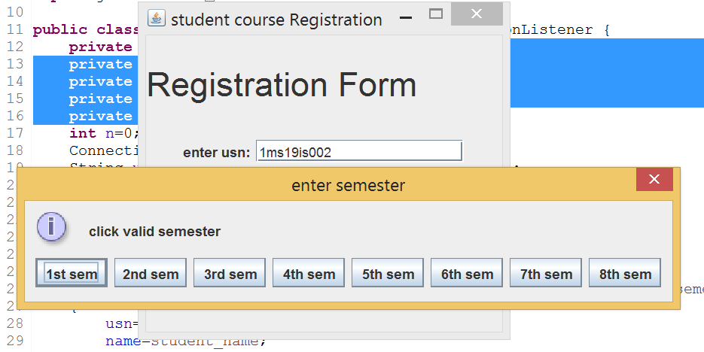
On the click of enter button we get to choose the semester. Select the semester for Registration.

Slide 7
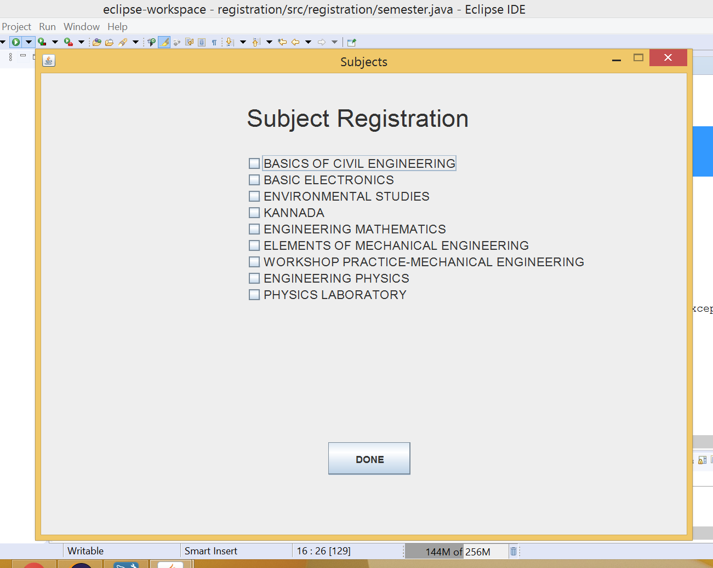
-> On selecting the semester. -> The subjects of the respective semesters are displayed.

Slide 8
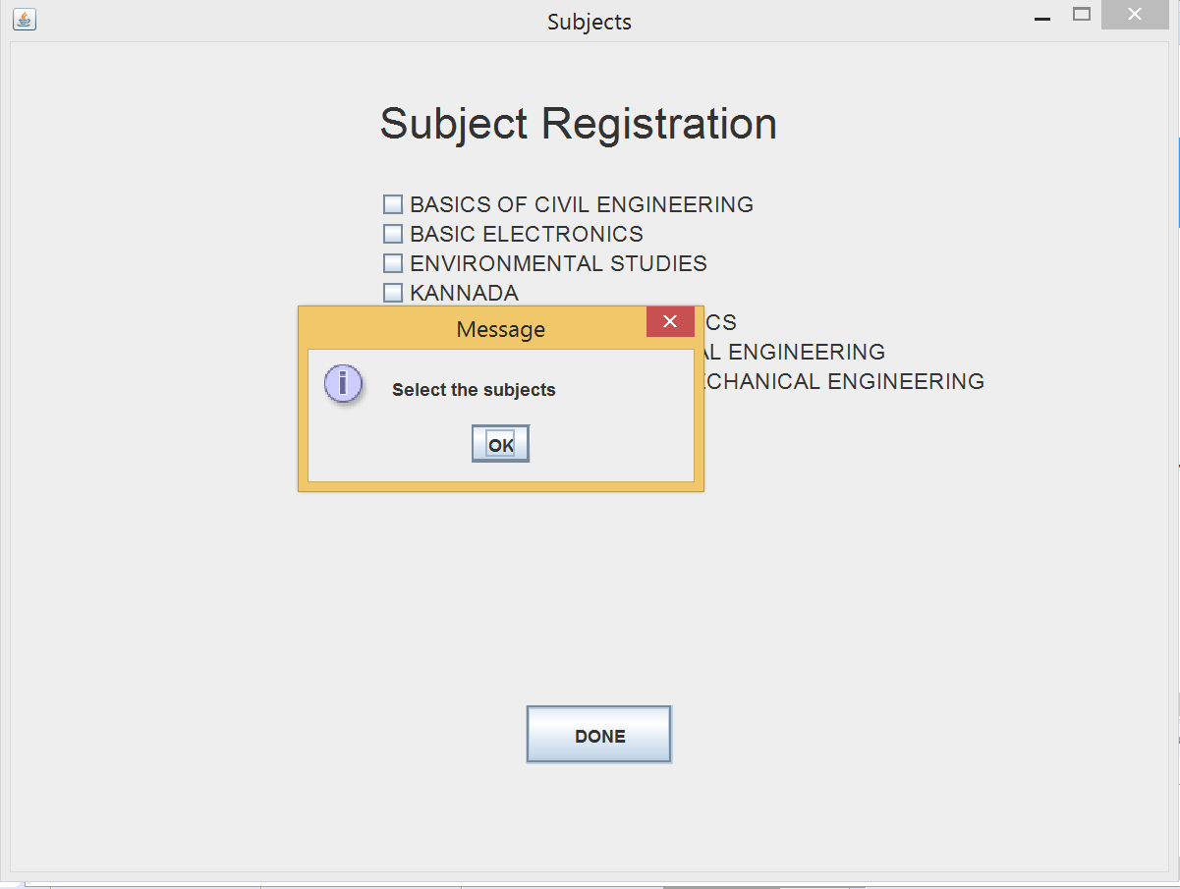
If none of the subjects are selected and we press the ‘Done’ button -> It shows a message

Slide 9
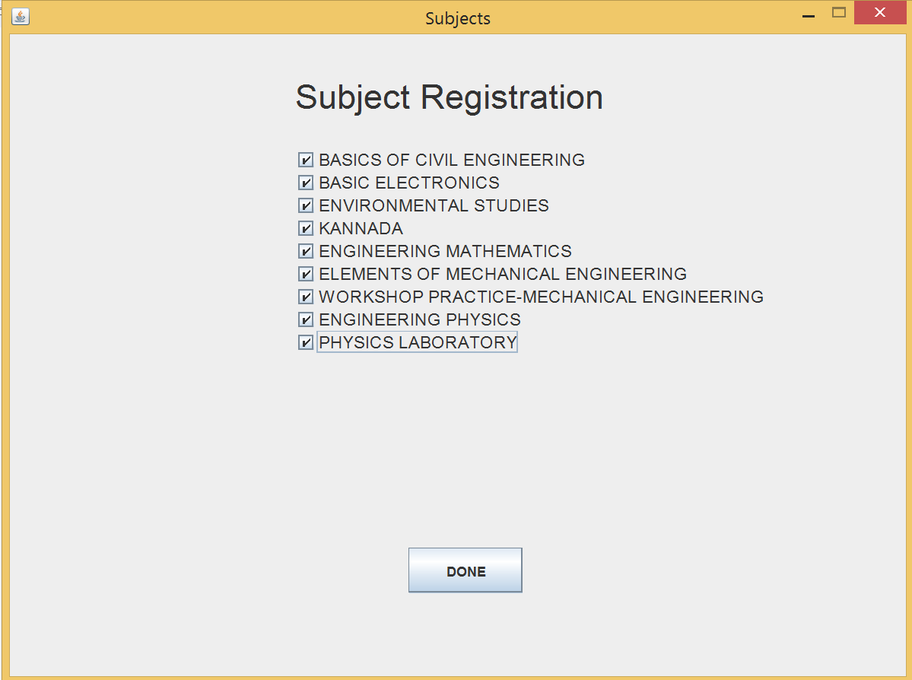
-> Selection of subjects to Register. -> Once completed, select ‘Done’.

Slide 10
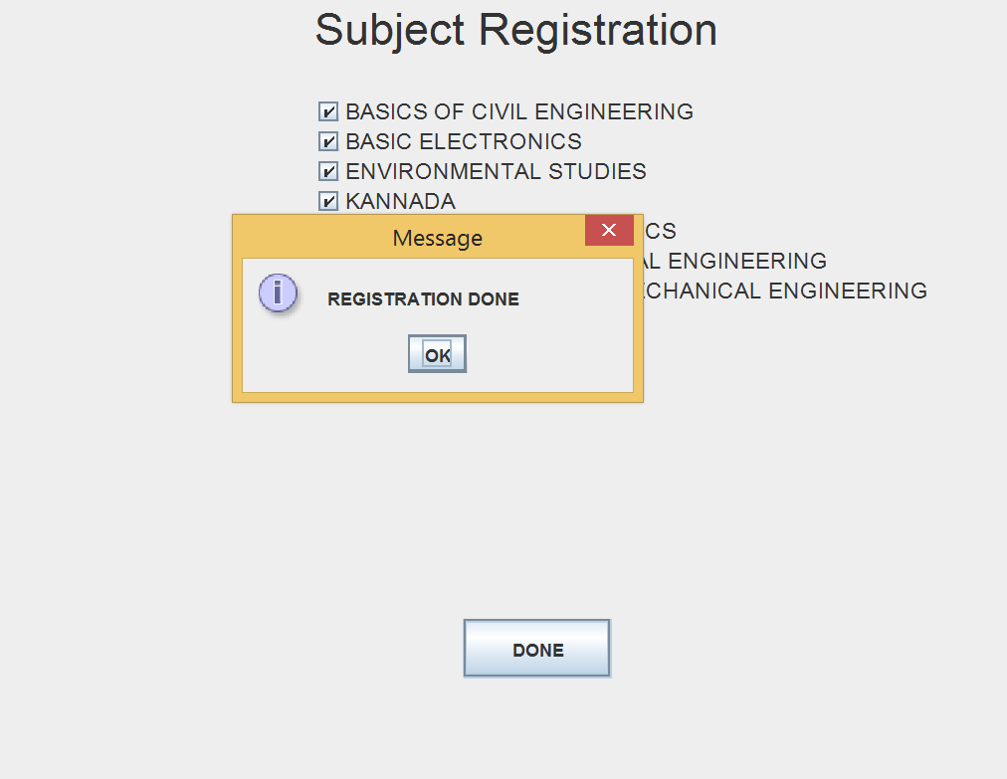
Display of Message, when registration is done for newly registering students(i.e. 1st semester students)

Slide 11
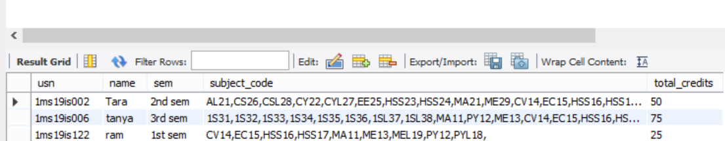
New record inserted into database.

Slide 12
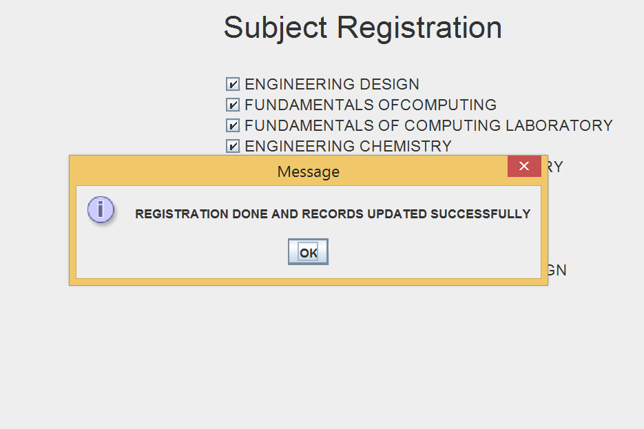
Display of Message, for students whose record exits in the Database. So we update record.

Slide 13
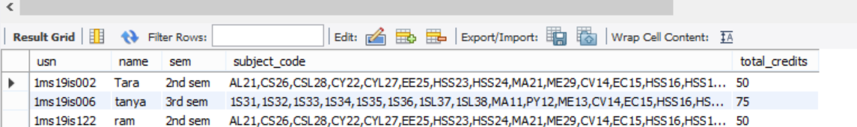
The updated record

Slide 14
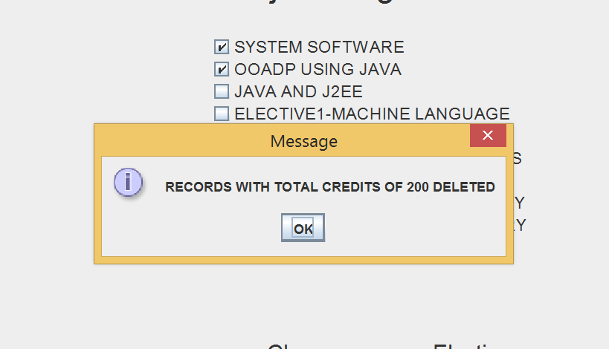
Display of Message , if record with totalCredits = 200 is deleted.

Slide 15
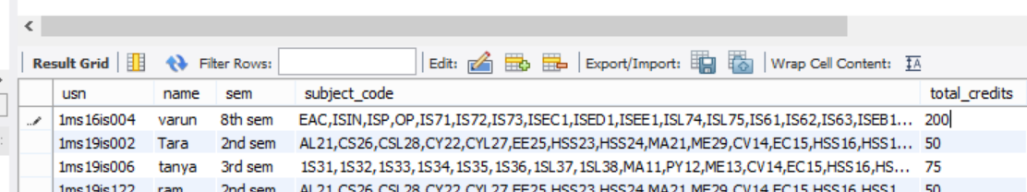
The record with totalCredits = 200 .

Slide 16
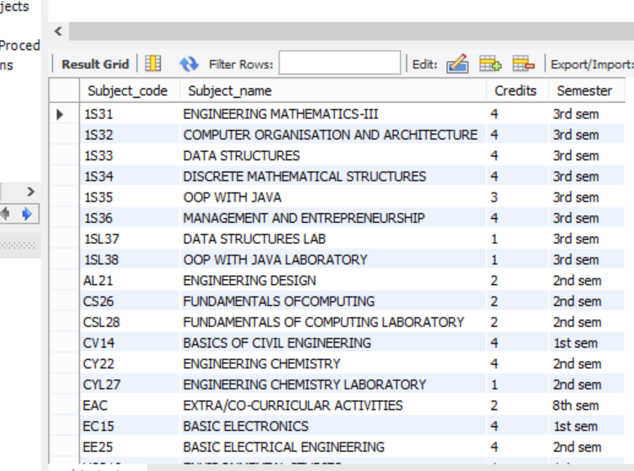
Database of subject details.

Slide 17
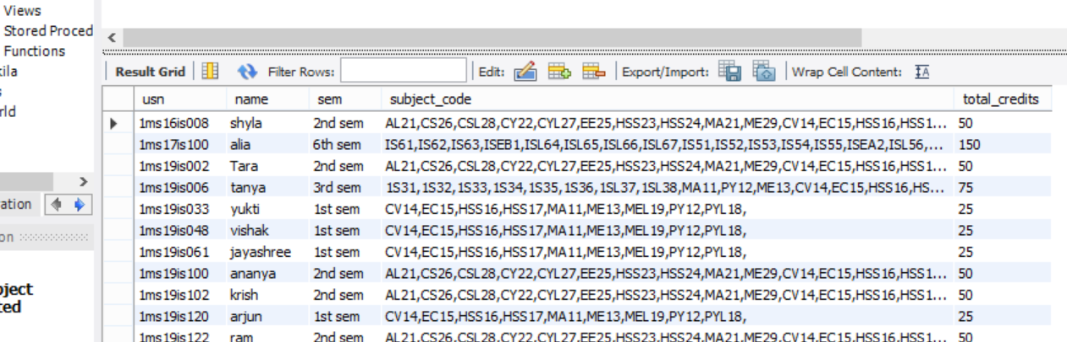
Database for storing the subject details.

Slide 18
THANK YOU

